Slide 1
TMS 2213
PROBABILITY & STATISTICS
Lecture 1
Eng. (Ms.) Usha Kawmadie

Slide 2
COURSE CONTENT
Lecture Weeks – 12
Evaluation
Mid Semester Examination – 20%
End Semester Examination - 80%
Written Examination – 50%
Practical Examination – 30%
Method of teaching and learning
Lectures practical and tutorials
Earn at least 50% of marks from continues assessments
Minimum of 80% attendance for the classes.

Slide 3
COURSE UNIT OBJECTIVES
The objective of this course is
to solve some practical problem by statistical methods.
to develop skills in thinking and analyzing problems from a probabilistic and statistical point of view.

Slide 4
PROBABILITY
Sets and Subsets
A set is a well-defined collection of objects.
Each object in a set is called an element of the set.
Two sets are equal if they have exactly the same elements in them.
A set that contains no elements is called a null set or an empty set.
If every element in Set A is also in Set B, then Set A is a subset of Set B

Slide 5
PROBABILITY
Basic Probability The probability of a sample point is a measure of the likelihood that the sample point will occur.
Probability of a Sample Point By convention, statisticians have agreed on the following rules.
The probability of any sample point can range from 0 to 1. The sum of probabilities of all sample points in a sample space is equal to 1.
Probability of an Event The probability of an event is a measure of the likelihood that the event will occur. By convention, statisticians have agreed on the following rules.
The probability of any event can range from 0 to 1. The probability of event A is the sum of the probabilities of all the sample points in event A. The probability of event A is denoted by P(A).
Thus, if event A were very unlikely to occur, then P(A) would be close to 0. And if event A were very likely to occur, then P(A) would be close to 1.

Slide 6
PROBABILITY
Notations
Set is usually denoted by a capital letter, such as A, B, or C.
An element of a set is usually denoted by a small letter, such as x, y, or z.
A set may be described by listing all of its elements enclosed in braces. For example, if Set A consists of the numbers
2, 4, 6, and 8, we may say: A = {2, 4, 6, 8}.
The null set is denoted by { } or ∅.
Sets may also be described by stating a rule. We could describe Set A from the previous example by stating:
Set A consists of all the even single-digit positive integers.

Slide 7
PROBABILITY
The Sample Space
A sample space is a set of elements that represents all possible outcomes of a statistical experiment. A sample point is an element of a sample space. An event is a subset of a sample space - one or more sample points.
Types of events
Two events are mutually exclusive if they have no sample points in common. Two events are independent when the occurrence of one does not affect the probability of the occurrence of the other.

Slide 8
CONDITIONAL PROBABILITY
The probability that Event A occurs, given that Event B has occurred, is called a conditional probability.
The conditional probability of Event A, given Event B, is denoted by the symbol P(A|B).
P(A|B) - The probability of event A given event B

Slide 9
STATISTICALLY INDEPENDENT EVENTS
Two events are independent if the occurrence of one event does not affect the chances of the occurrence of the other event.
For Independent Events P(E|F) = P(E)
For Independent Events P(E and F) = P(E)P(F)

Slide 10
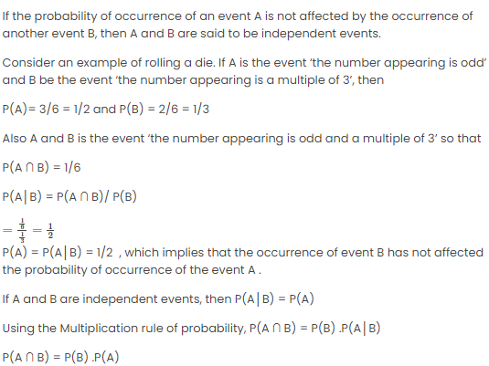
STATISTICALLY INDEPENDENT EVENTS

Slide 11
RULES OF PROBABILITY
We want to compute the probability of an event from the known probabilities of other events.
Definitions and Notation
Two events are mutually exclusive or disjoint if they cannot occur at the same time.
The complement of an event is the event not occurring. The probability that Event A will not occur is denoted by P(A').
The probability that Events A and B both occur is the probability of the intersection of A and B. The probability of the intersection of Events A and B is denoted by P(A ∩ B). If Events A and B are mutually exclusive, P(A ∩ B) = 0.
The probability that Events A or B occur is the probability of the union of A and B. The probability of the union of Events A and B is denoted by P(A ∪ B) .
If the occurrence of Event A changes the probability of Event B, then Events A and B are dependent. On the other hand, if the occurrence of Event A does not change the probability of Event B, then Events A and B are independent

Slide 12
RULES OF PROBABILITY
We want to compute the probability of an event from the known probabilities of other events.
Rule of Subtraction
Two important properties of probability:
The probability of an event ranges from 0 to 1.
The sum of probabilities of all possible events equals 1.
The rule of subtraction follows directly from these properties
Rule of Subtraction - The probability that event A will occur is equal to 1 minus the probability that event A will not occur.
P(A) = 1 - P(A')

Slide 13
Rules of probability
We want to compute the probability of an event from the known probabilities of other events.
Rule of Multiplication The rule of multiplication applies to the situation when we want to know the probability of the intersection of two events; that is, we want to know the probability that two events (Event A and Event B) both occur.
Rule of Multiplication - The probability that Events A and B both occur is equal to the probability that Event A occurs times the probability that Event B occurs, given that A has occurred.
P(A ∩ B) = P(A) P(B|A)

Slide 14
RULES OF PROBABILITY
We want to compute the probability of an event from the known probabilities of other events.
Rule of Addition The rule of addition applies if we have two events, and we want to know the probability that either event occurs.
Rule of Addition - The probability that Event A and/or Event B occur is equal to the probability that Event A occurs plus the probability that Event B occurs minus the probability that both Events A and B occur.
P(A U B) = P(A) + P(B) - P(A ∩ B))
Note: Invoking the fact that P(A ∩ B) = P( A )P( B | A ), the Addition Rule can also be expressed as
P(A U B) = P(A) + P(B) - P(A)P( B | A )

Slide 15
THANK YOU
usha@fot.ruh.ac.lk

